Slide 1
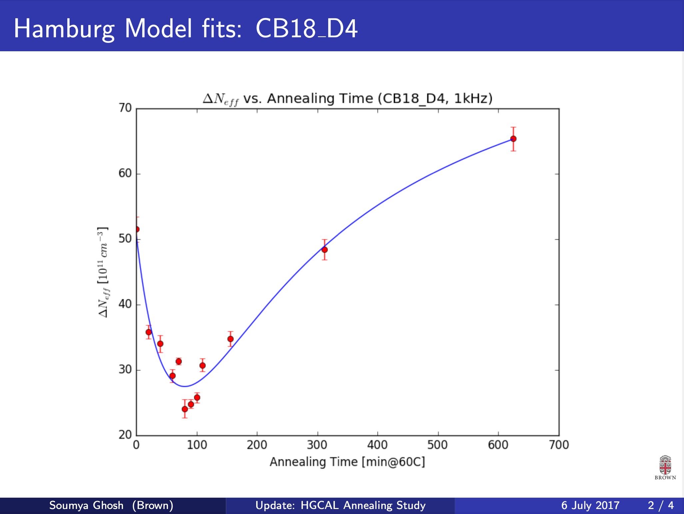
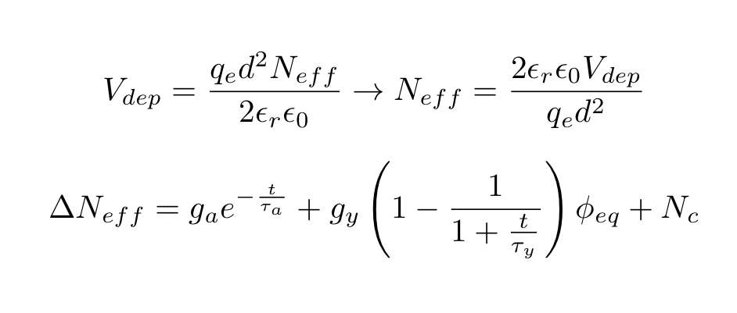
HGCAL Hamburg Model Analysis

Slide 2
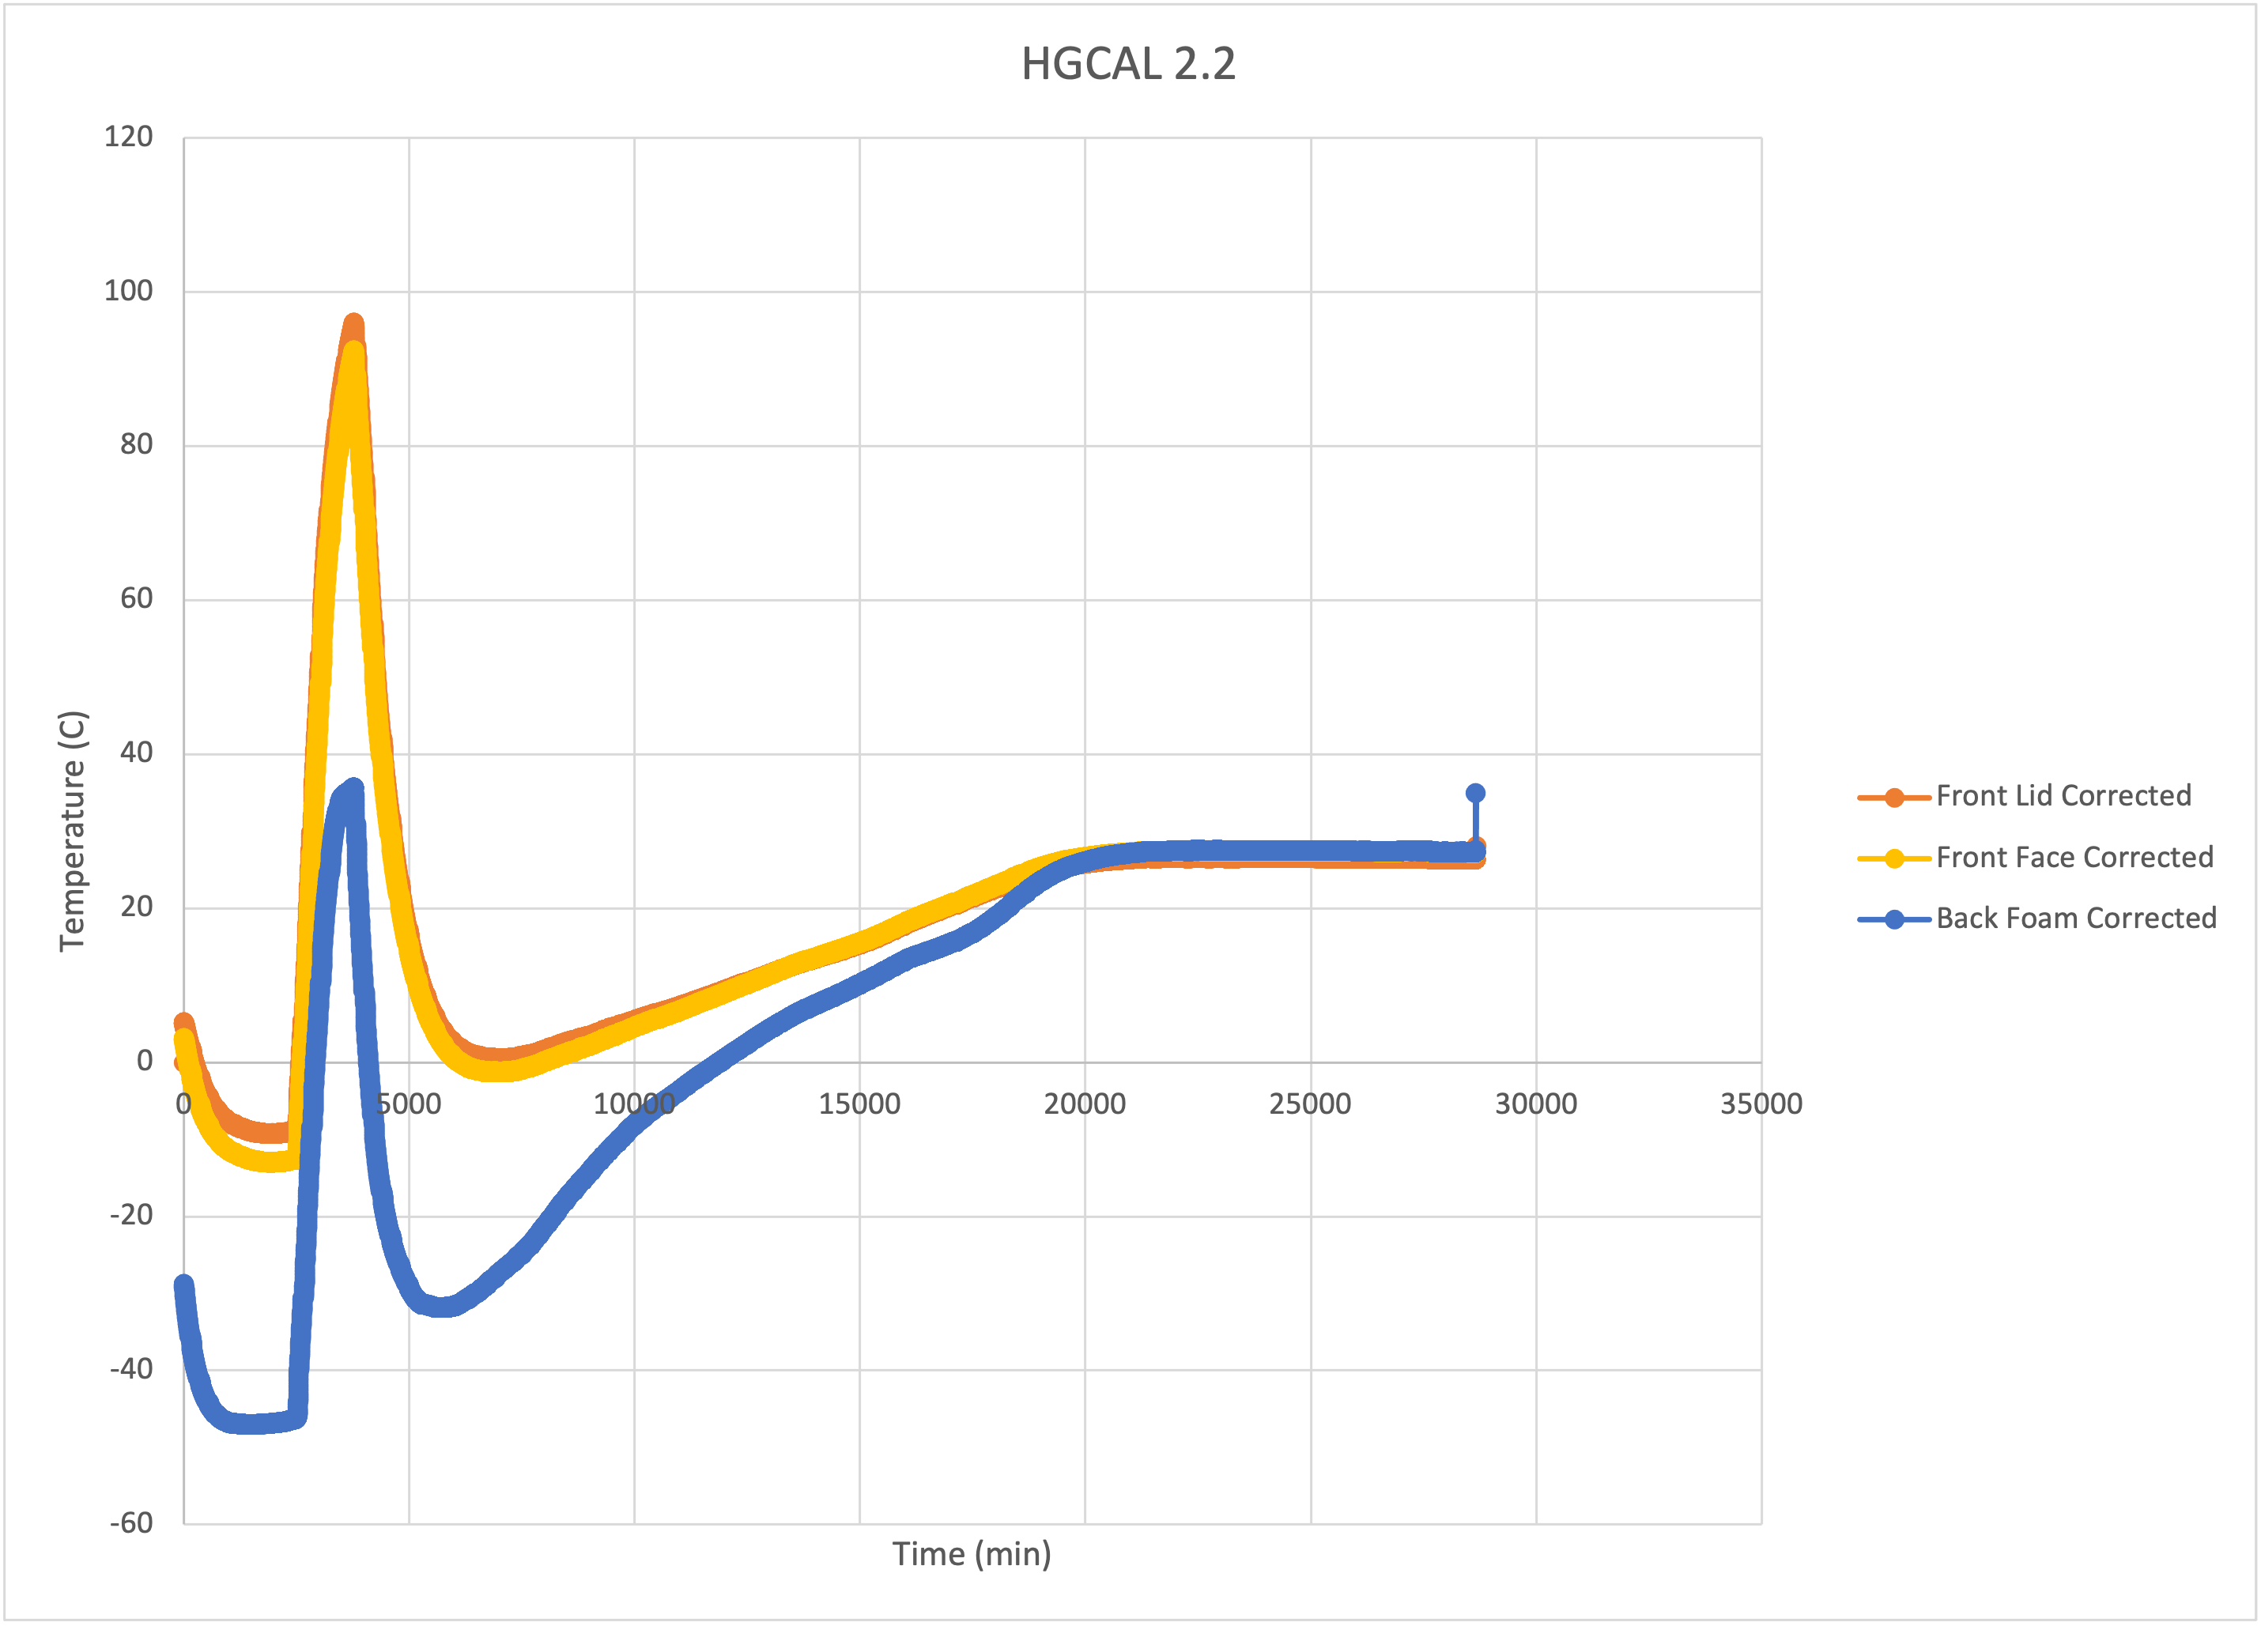
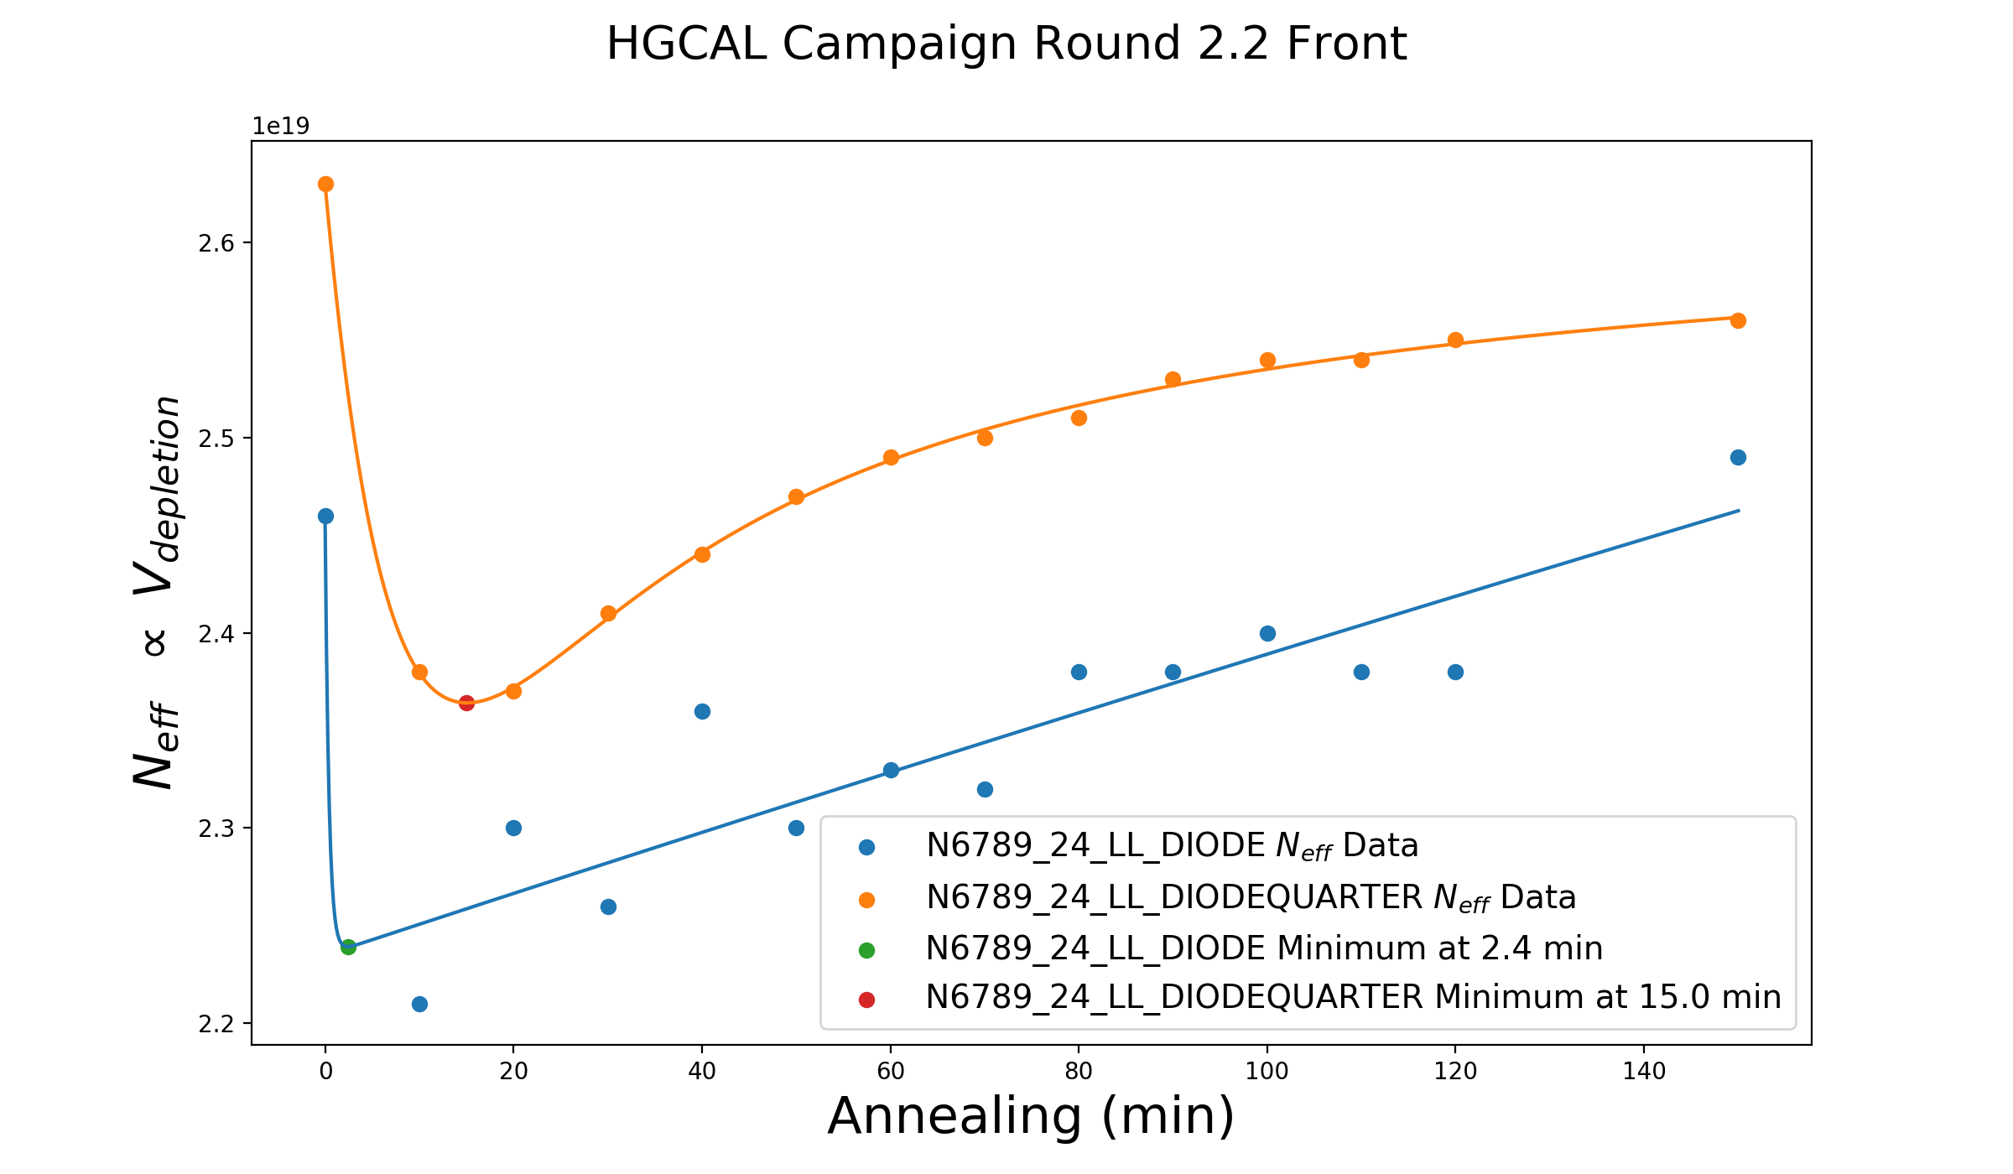
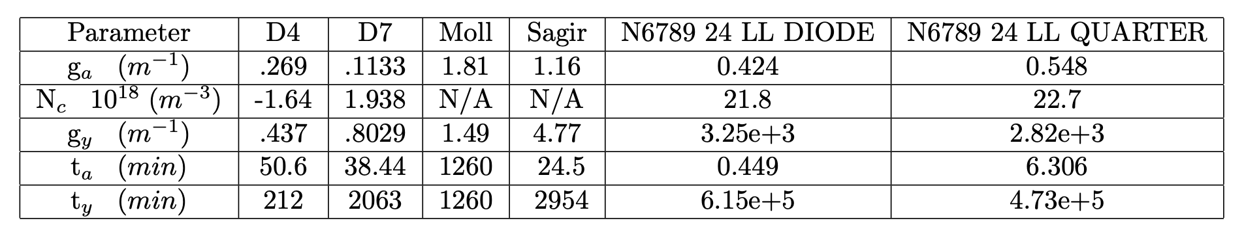
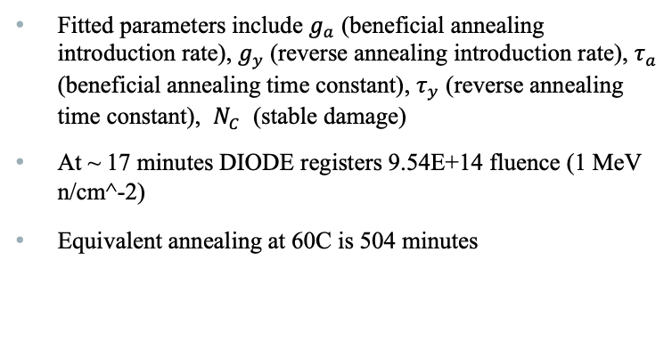
HGCAl 2.2 Front (43 min)
Fitted parameters include $g_{a}$ (beneficial annealing introduction rate), $g_{y}$(reverse annealing introduction rate), $τ_{a}$ (beneficial annealing time constant), $τ_{y}$ (reverse annealing time constant), $N_{C}$ (stable damage)
At ~ 17 minutes DIODE registers 9.54E+14 fluence (1 MeV n/cm^-2)
Equivalent annealing at 60C is 504 minutes

Slide 3
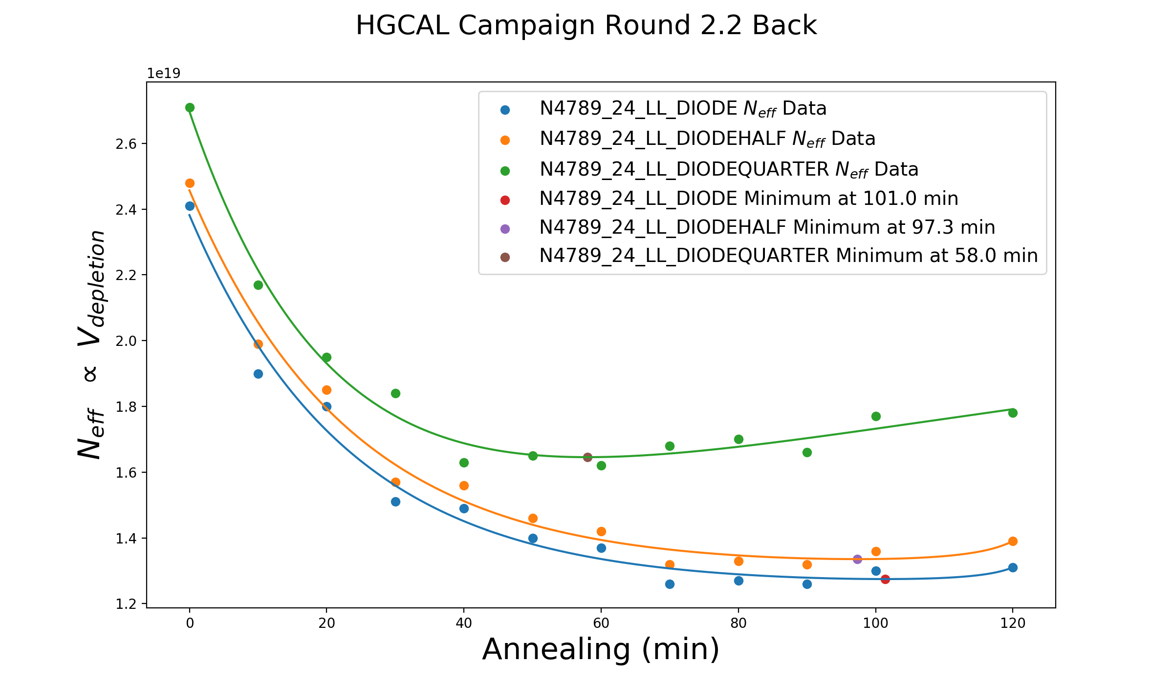
HGCAl 2.2 back (43 min)
At ~ 90 minutes DIODE registers 1.35E+15 fluence (1 MeV n/cm^-2)
Equivalent annealing at 60C is 6.01 minutes

Slide 4
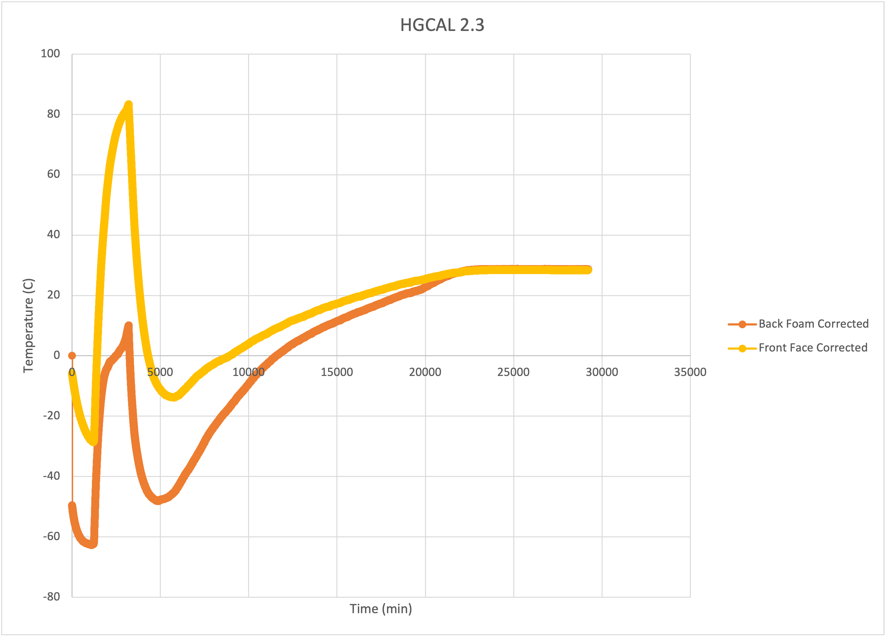
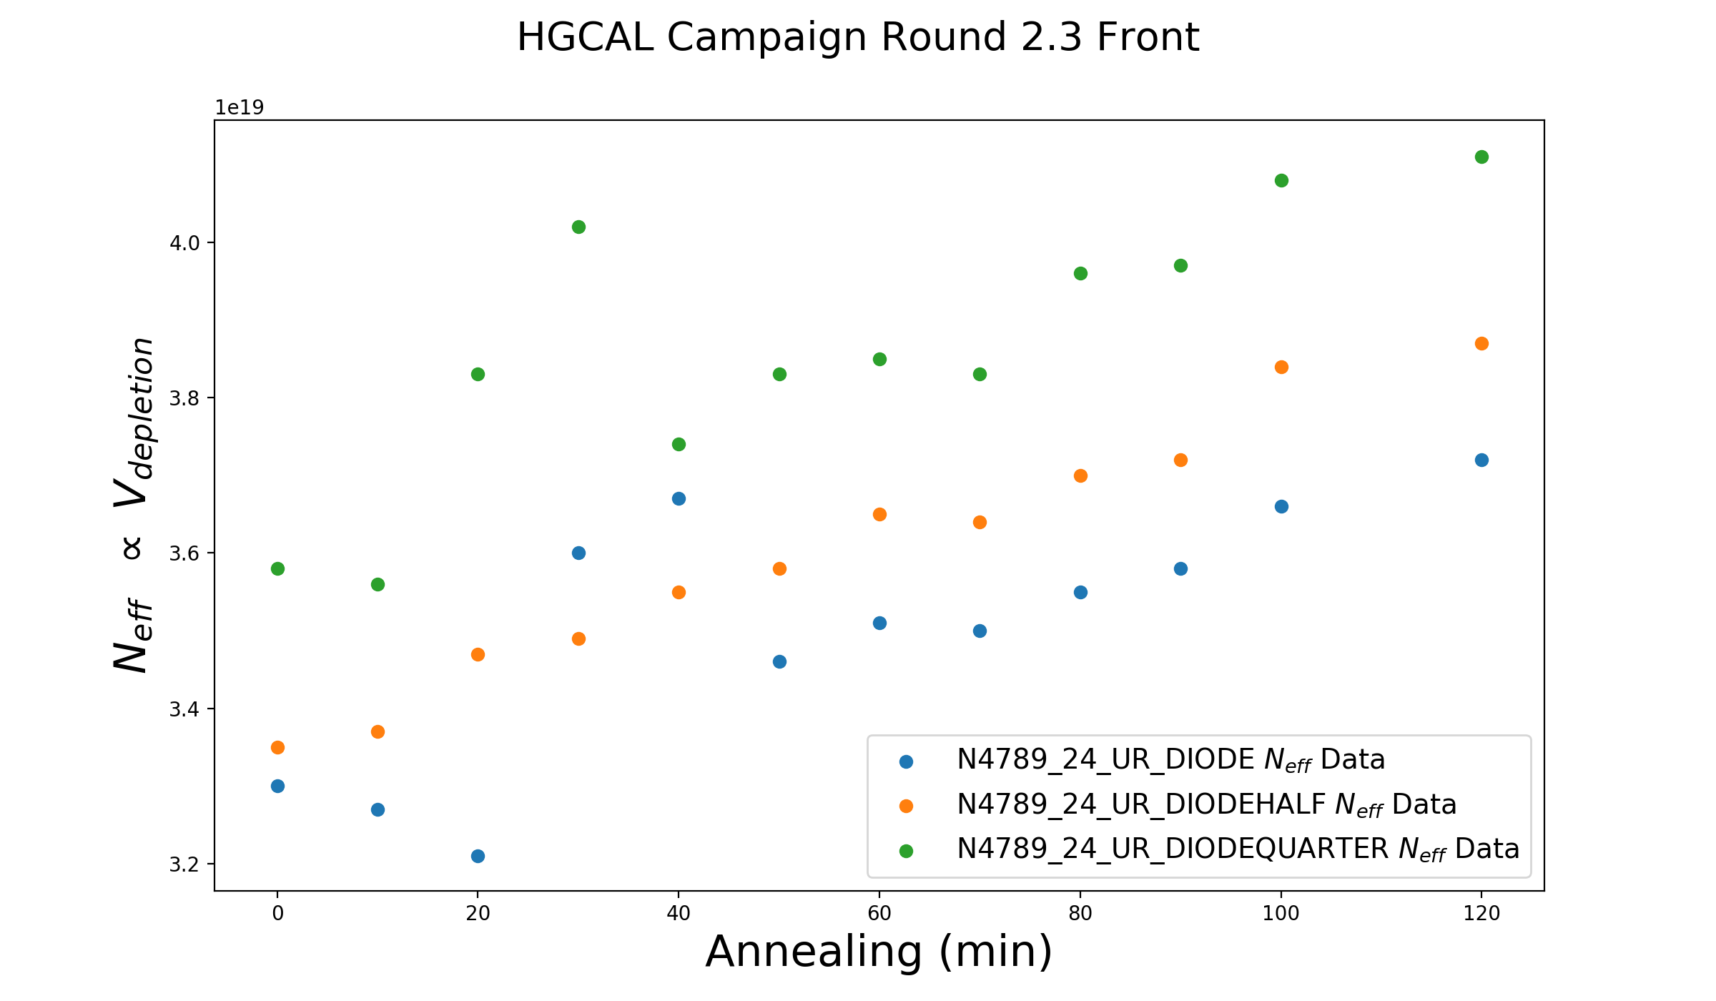
HGCAl 2.3 Front (86 min)
At 0 minutes DIODE registers 2.08E+15 fluence (1 MeV n/cm^-2)
Not able to make a fit to the Hamburg Model, because the front HGCAL cutout experience so much annealing during irradiation
Equivalent annealing at 60C:
Front: 374 min
Back: 5.62 min

Slide 5
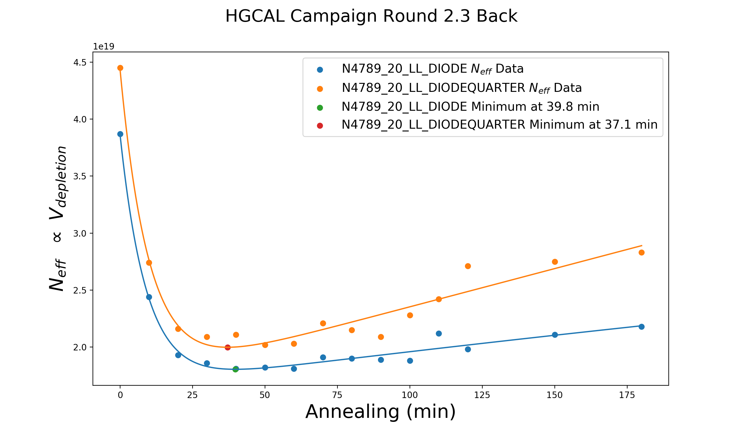
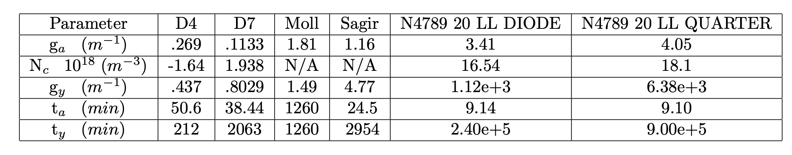
HGCAl 2.3 back (86 min)
At ~ 40 minutes DIODE registers 2.78E+15 fluence (1 MeV n/cm^-2)
Equivalent annealing at 60C:
Front: 374 min
Back: 5.62 min

Slide 6
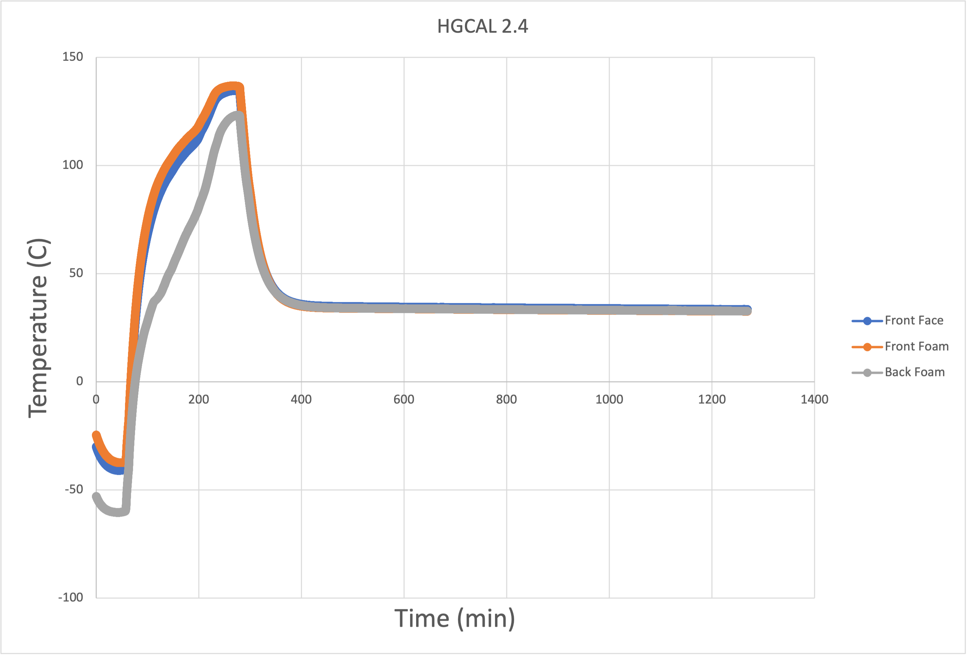
HGCAl 2.4 Back (216 min)
At 0 minutes DIODE registers 1.84E+16 fluence (1 MeV n/cm^-2)
Front HGCAL & D0 Diodes Destroyed during Irradiation
Depletion Hit 1000 V’s for first two annealing steps, thus the overlapping data
Not able to make a fit to the Hamburg Model, because the back HGCAL cutout experience so much annealing during irradiation
Equivalent annealing at 60C:
Front: 106,709 min
Back: 27,252 min

Slide 7
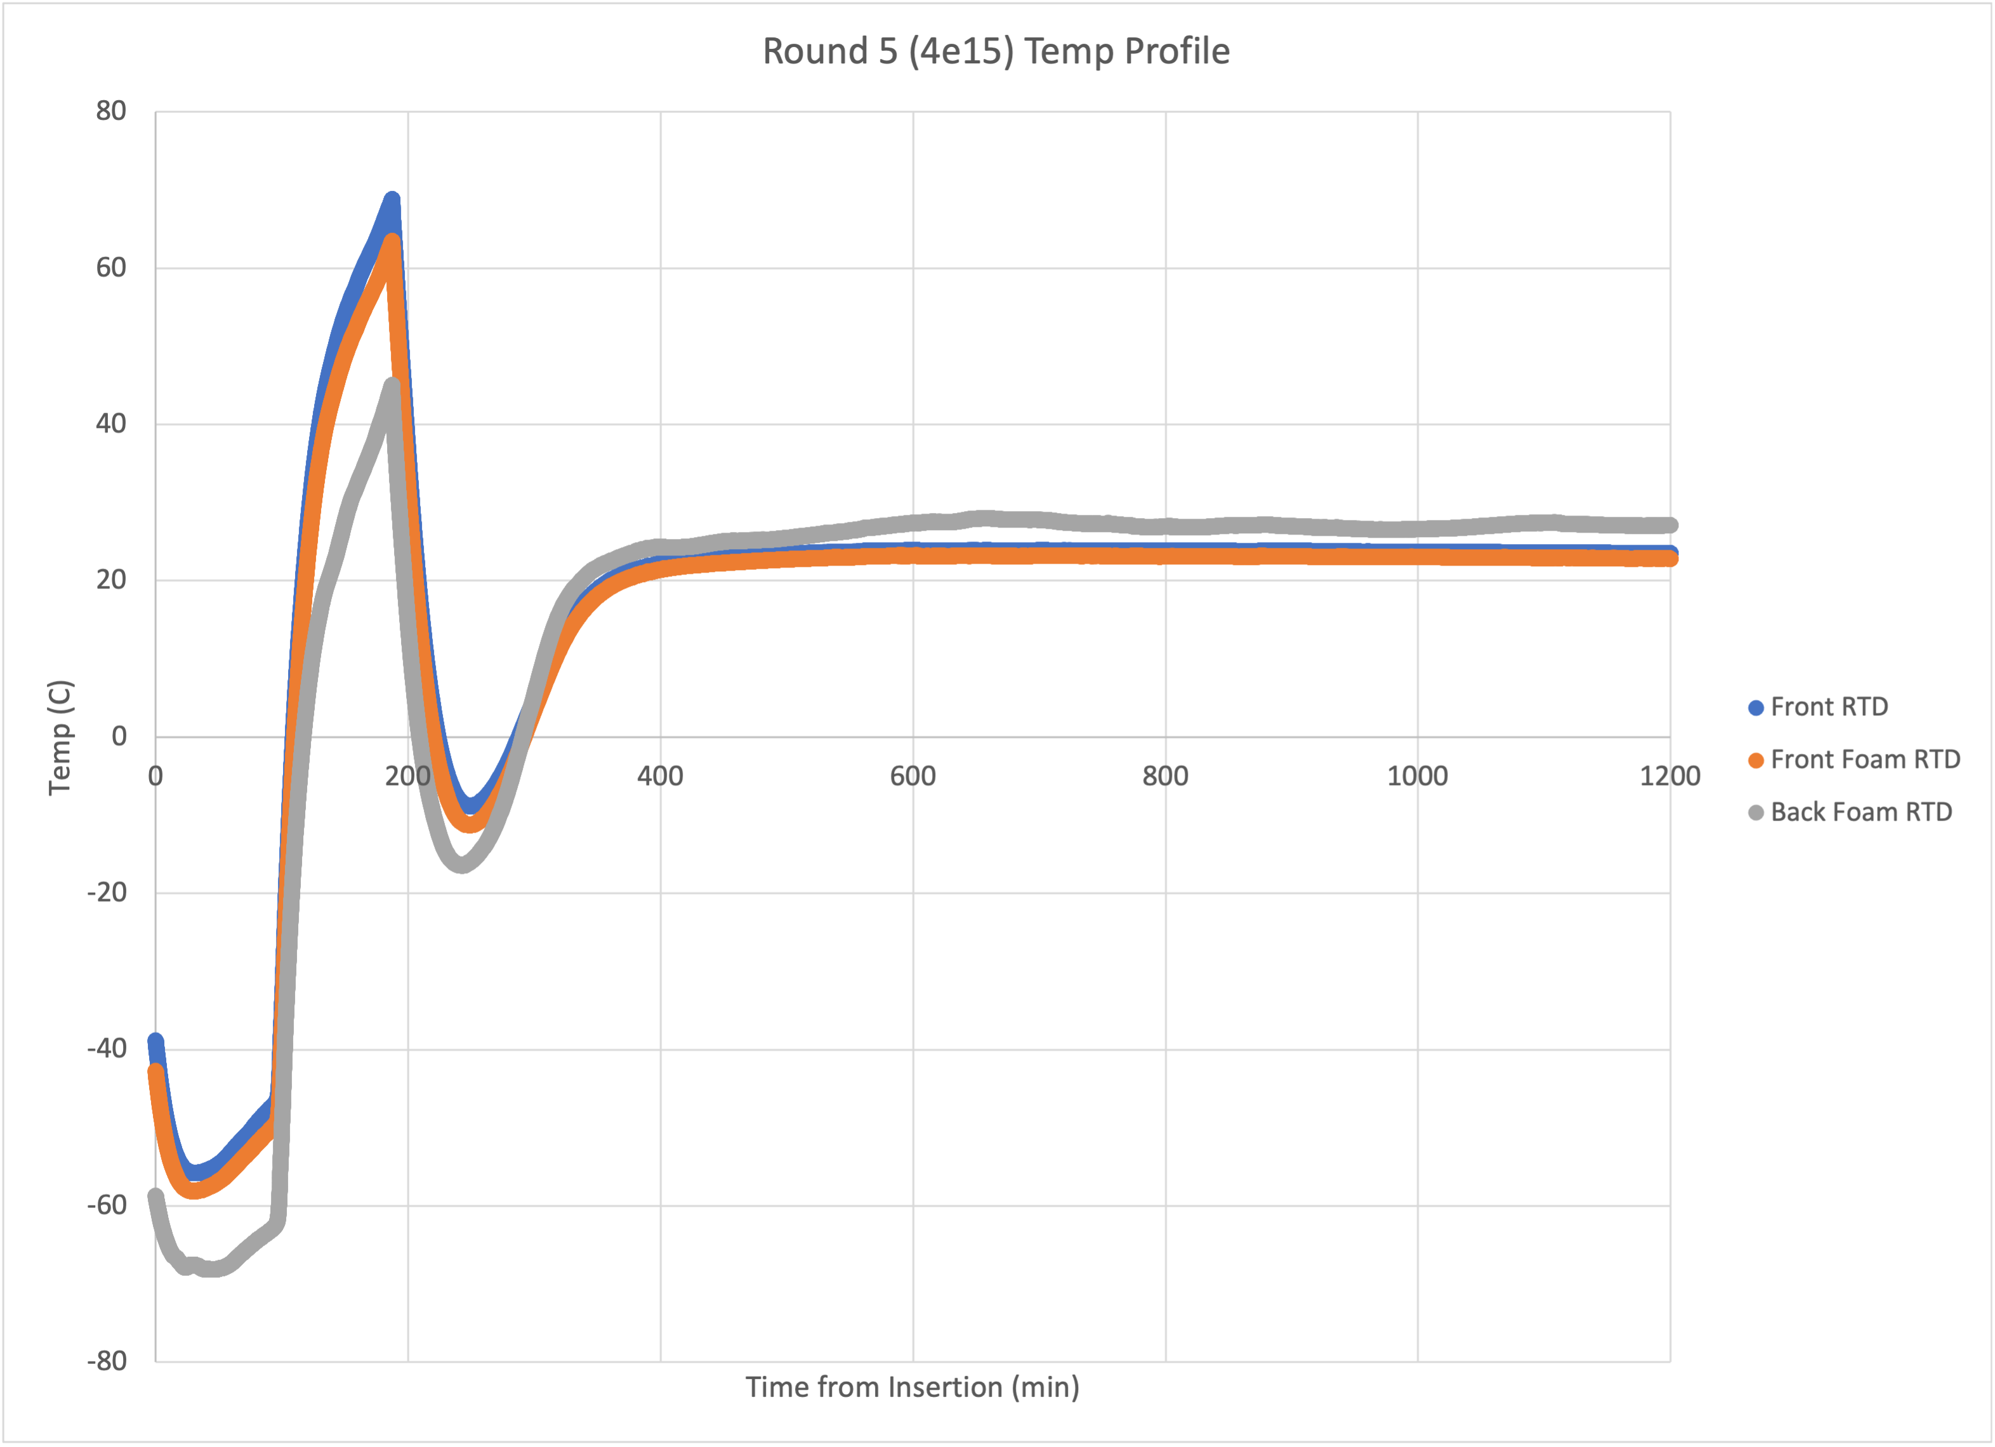
HGCAl 2.5 Front (86 min)
At ~60 minutes DIODE registers 2.81E+15 fluence (1 MeV n/cm^-2)
Equivalent annealing at 60C is 69.17 minutes

Slide 8
HGCAl 2.5 back (86 min)
At ~80 minutes DIODE registers 3.09E+15 fluence (1 MeV n/cm^-2)
Equivalent annealing at 60C is 11 minutes

Slide 9
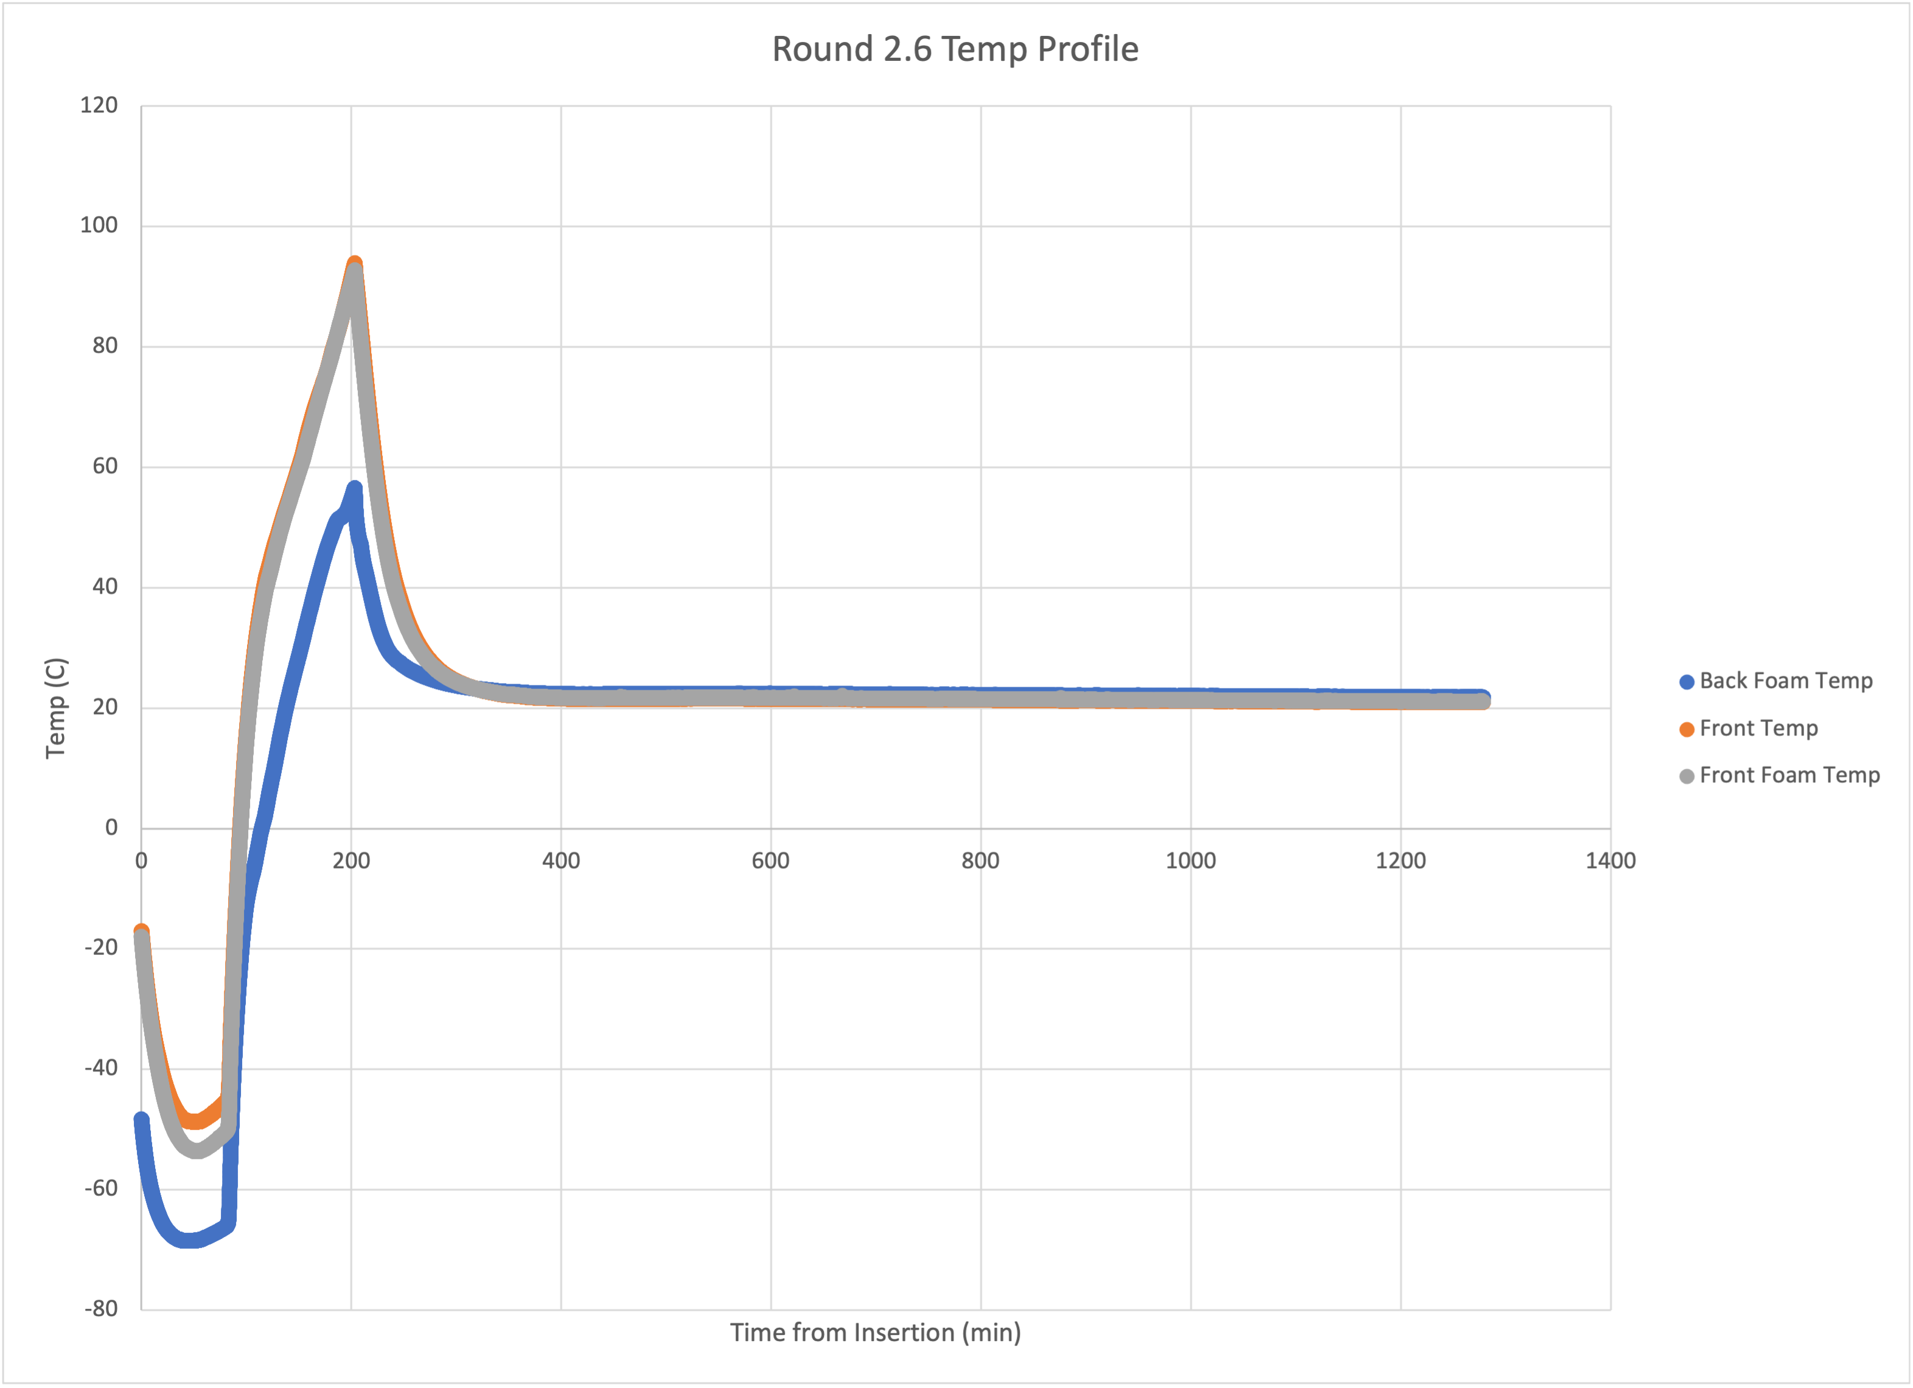
HGCAl 2.6 Front (118 min)
At 0 minutes DIODE registers 2.86E+15 fluence (1 MeV n/cm^-2)
Equivalent annealing at 60C is 739.3 minutes

Slide 10
HGCAl 2.6 back (118 min)
At 80 minutes DIODE registers 5.30E+15 fluence (1 MeV n/cm^-2)
Equivalent annealing at 60C is 20.6 minutes

Slide 11
Comments
Difference between maximum and minimum estimated fluence during Hamburg analysis:
2.2 Front: 1.56E+15 vs. 1.46+15
2.3 Back: 3.99E+15 vs. 2.30E+15
Excellent Dep V estimates throughout analysis
Have initial estimates for DIODEHALF and DIODEQUARTER area, fluence estimates for same cutout are ~5% off for HALF and ~15% off for QUARTER
HGCAL 2.5 (86 minutes) both F and B’s DepV Decreasing w/ annealing analysis

